Slide 1
Controller Tuning and Process Identification
Lec-12
Instrumentation and Process Control – ChE-323

Slide 2
Controller Tuning and Process Identification
Controller tuning
  Adjustment of controller parameters to achieve satisfactory control
Process Identification
  Determining the model of a process experimentally

Slide 3
Controller Types and Parameters
Proportional Controller
Proportional-Integral Controller
Proportional-Integral-Derivative Controller
Control Parameters
  K_{c}
  τ_{I}
  τ_{D}
Parameter selection is an optimization problem
  Satisfy criterion of optimality – good control
Optimization can be based on
  Trial and error
  Model based optimization

Slide 4
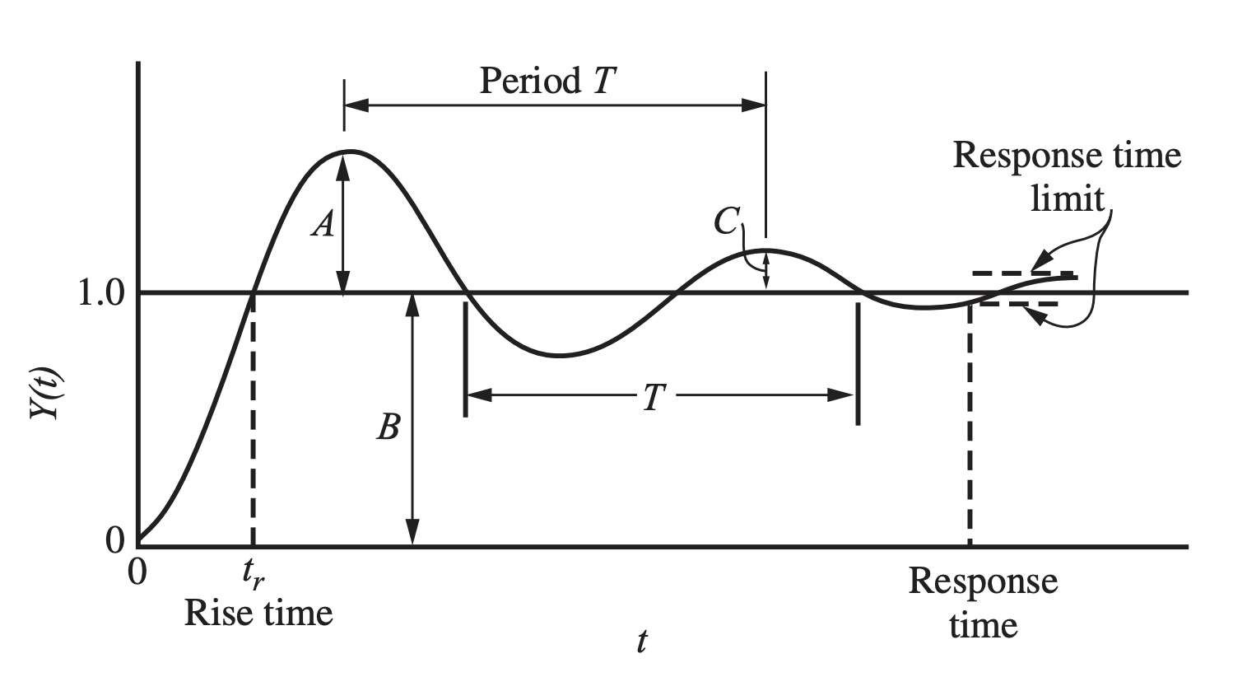
Optimization criterion
For most cases, a process model is not available
  Criterion is vaguely defined
Typical criterion for good control
  Response to a step input has
    Minimum overshoot
    One-quarter decay ratio
  Minimum rise time - the time it takes for the system's output to transition from 10% to 90% of its final value in response to a step input
  Minimum settling time - the duration it takes for a system's output to reach and maintain a steady-state value within a specified tolerance band, typically within 2% or 5% of the final value

Slide 5
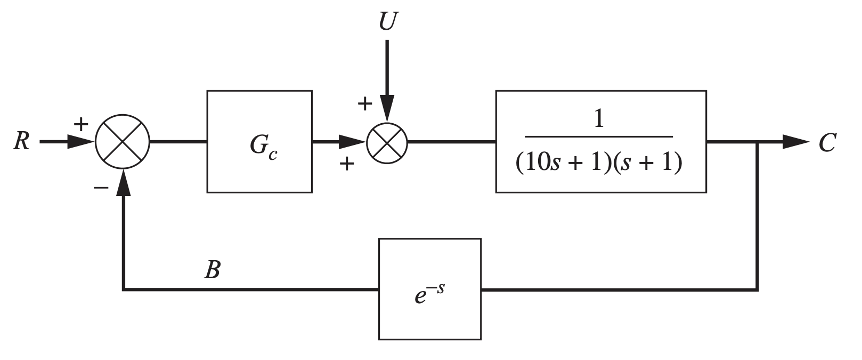
Controller Tuning
Effect of PID controller modes
Considering a loop with second order process and measuring element as transport lag
Response of step change in load is tested with different control modes
Second order process with transport lag

Slide 6
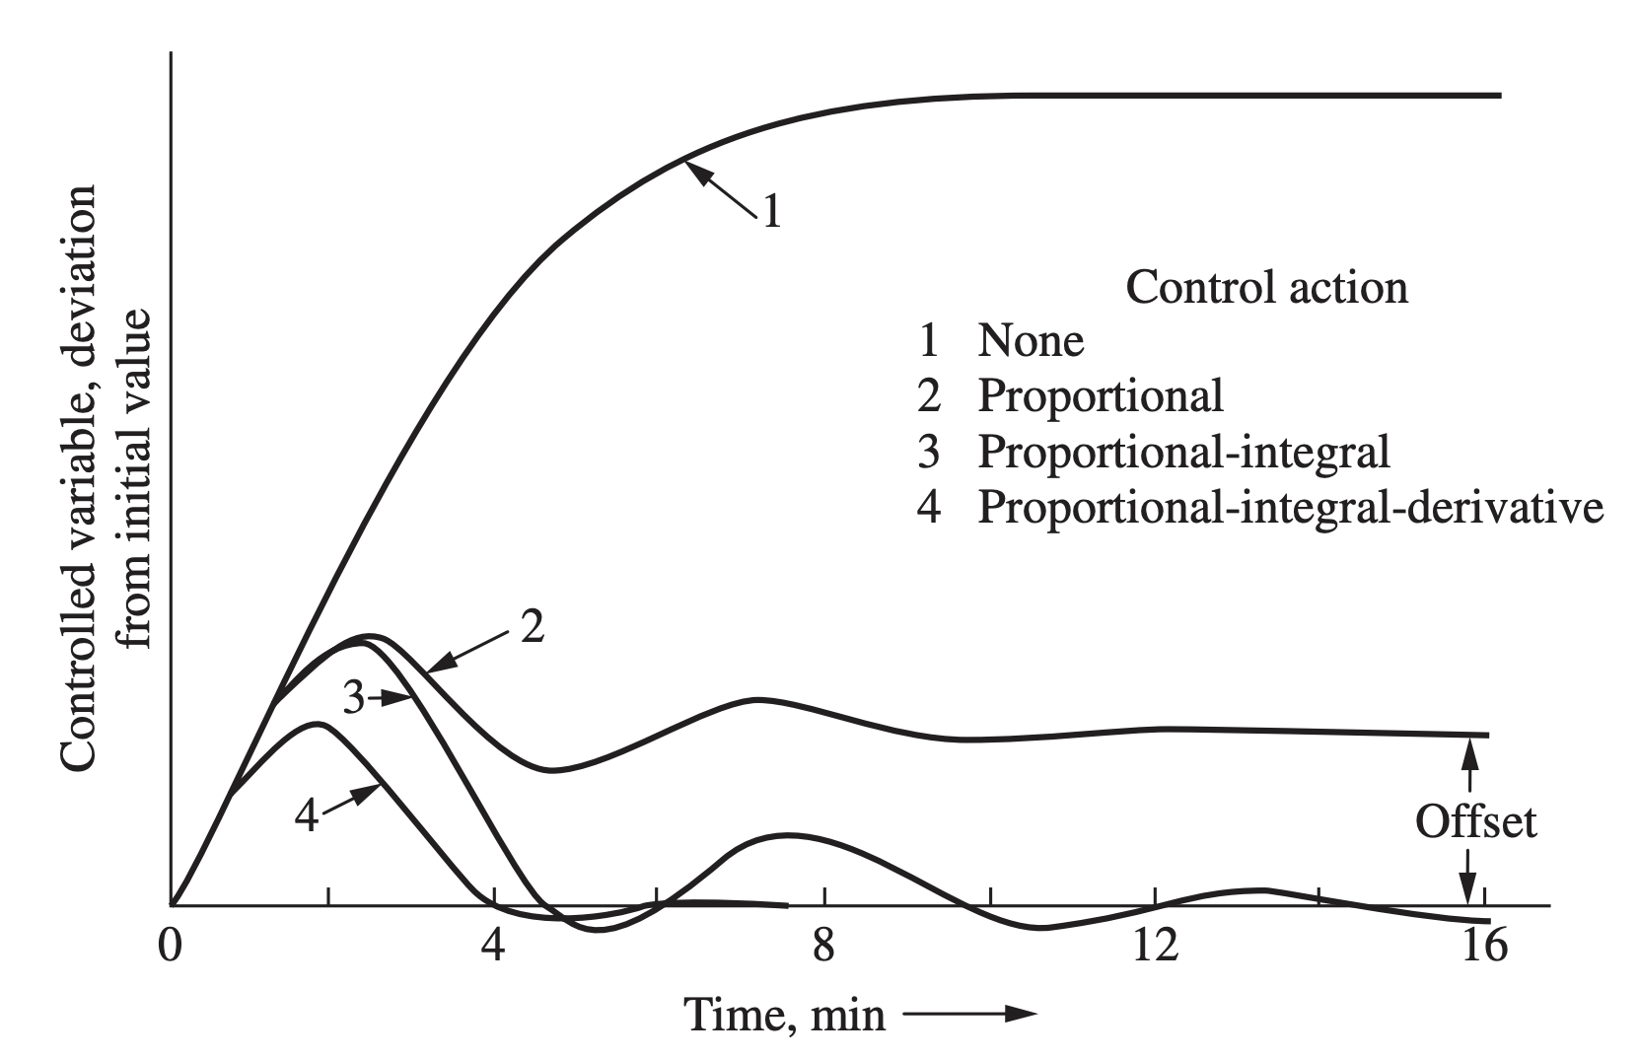
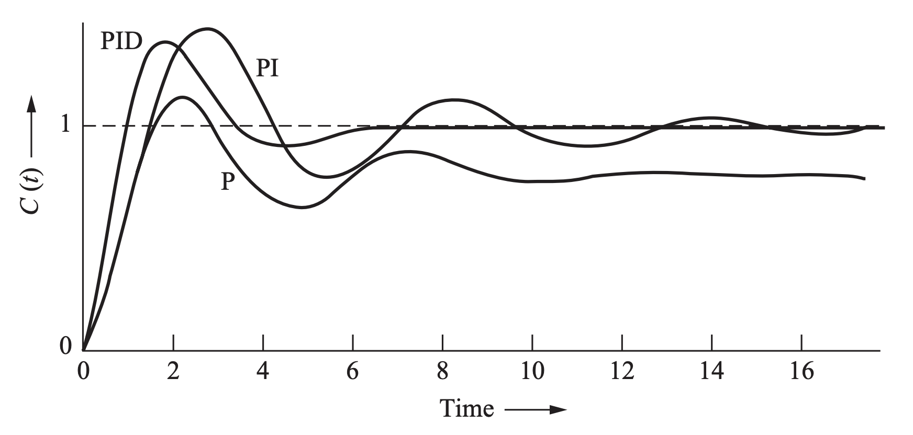
Controller Tuning
Effect of PID controller modes
Closed loop response to step change in load
Closed loop response to step change in set point

Slide 7
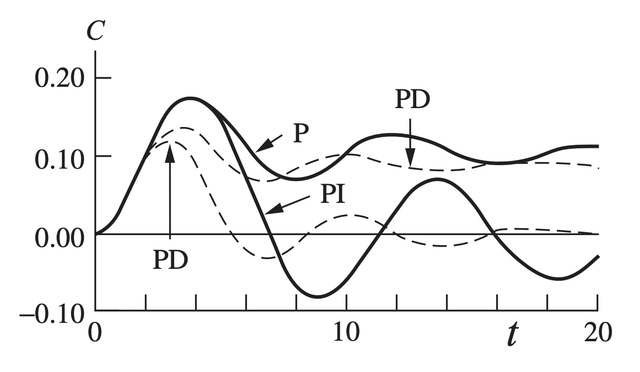
Controller Tuning
Effect of PID controller modes
Response of step change in load is tested with different control modes
  Well tuned responses are shown
  Integral action – eliminates offset
  Derivative action – speeds up the response
Load response with different control modes

Slide 8
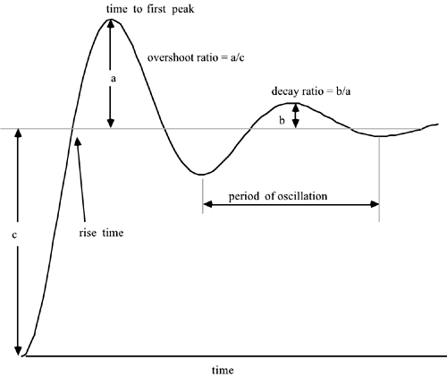
Controller Tuning
Criteria for good control
Figure of merit
  A criterion that reduces the entire response to a single number
  Used to compare different control parameters
Nature of response and requirements for the process determine the “best” choice of parameters

Slide 9
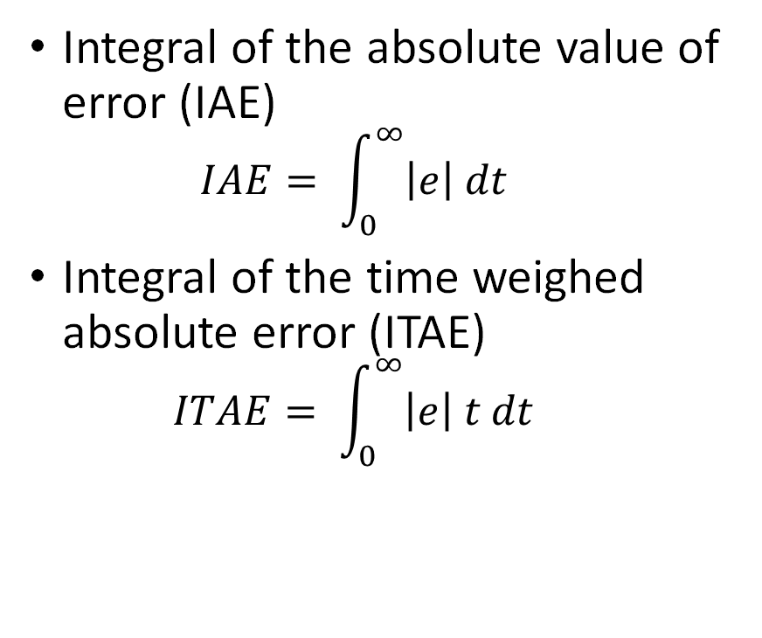
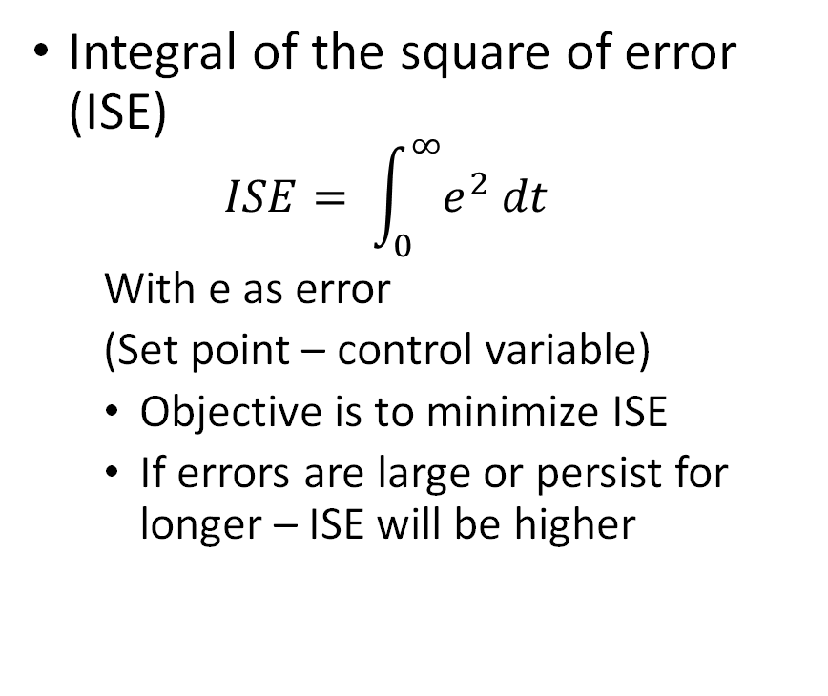
Controller Tuning
Criteria for good control
Integral of the square of error (ISE)
  $$ISE= \int_{0}^{∞}{e^{2} dt}$$
  With e as error
  (Set point – control variable)
  Objective is to minimize ISE
  If errors are large or persist for longer – ISE will be higher
Integral of the absolute value of error (IAE)
  $$IAE= \int_{0}^{∞}{\left|e\right| dt}$$
Integral of the time weighed absolute error (ITAE)
  $$ITAE= \int_{0}^{∞}{\left|e\right| t dt}$$

Slide 10
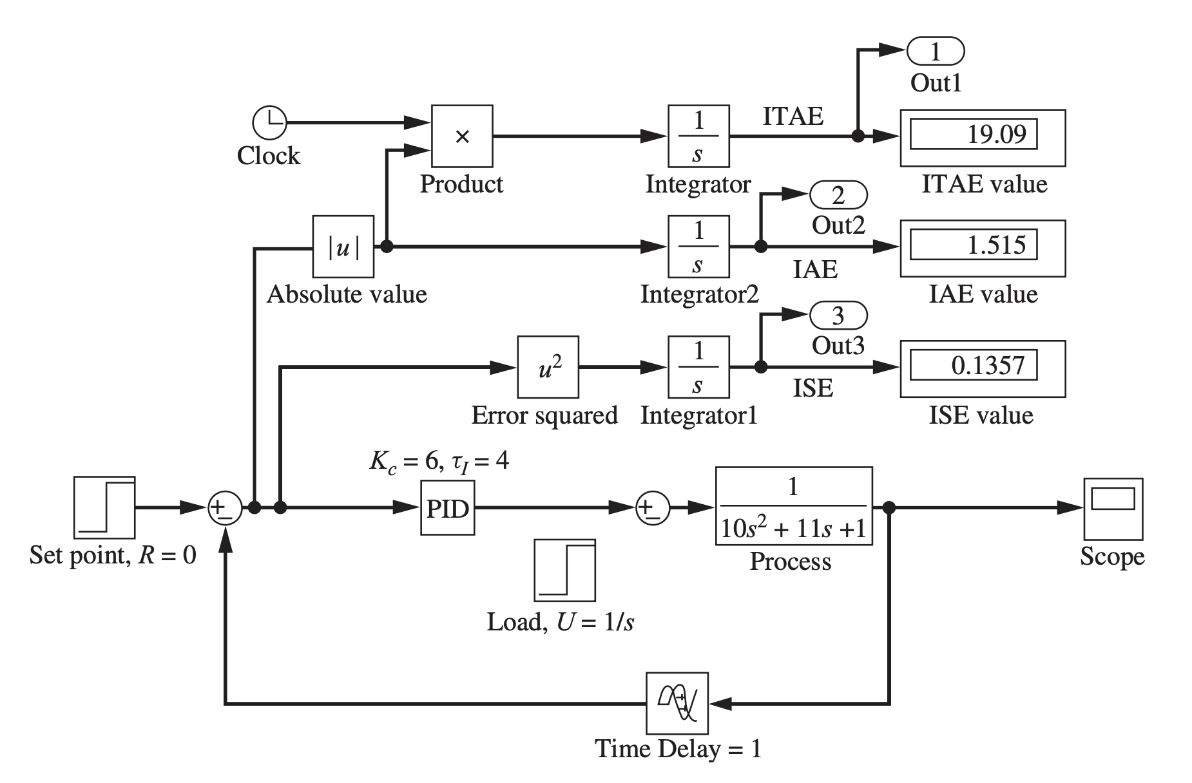
Controller Tuning
Criteria for good control
Control criteria applied to PI control

Slide 11
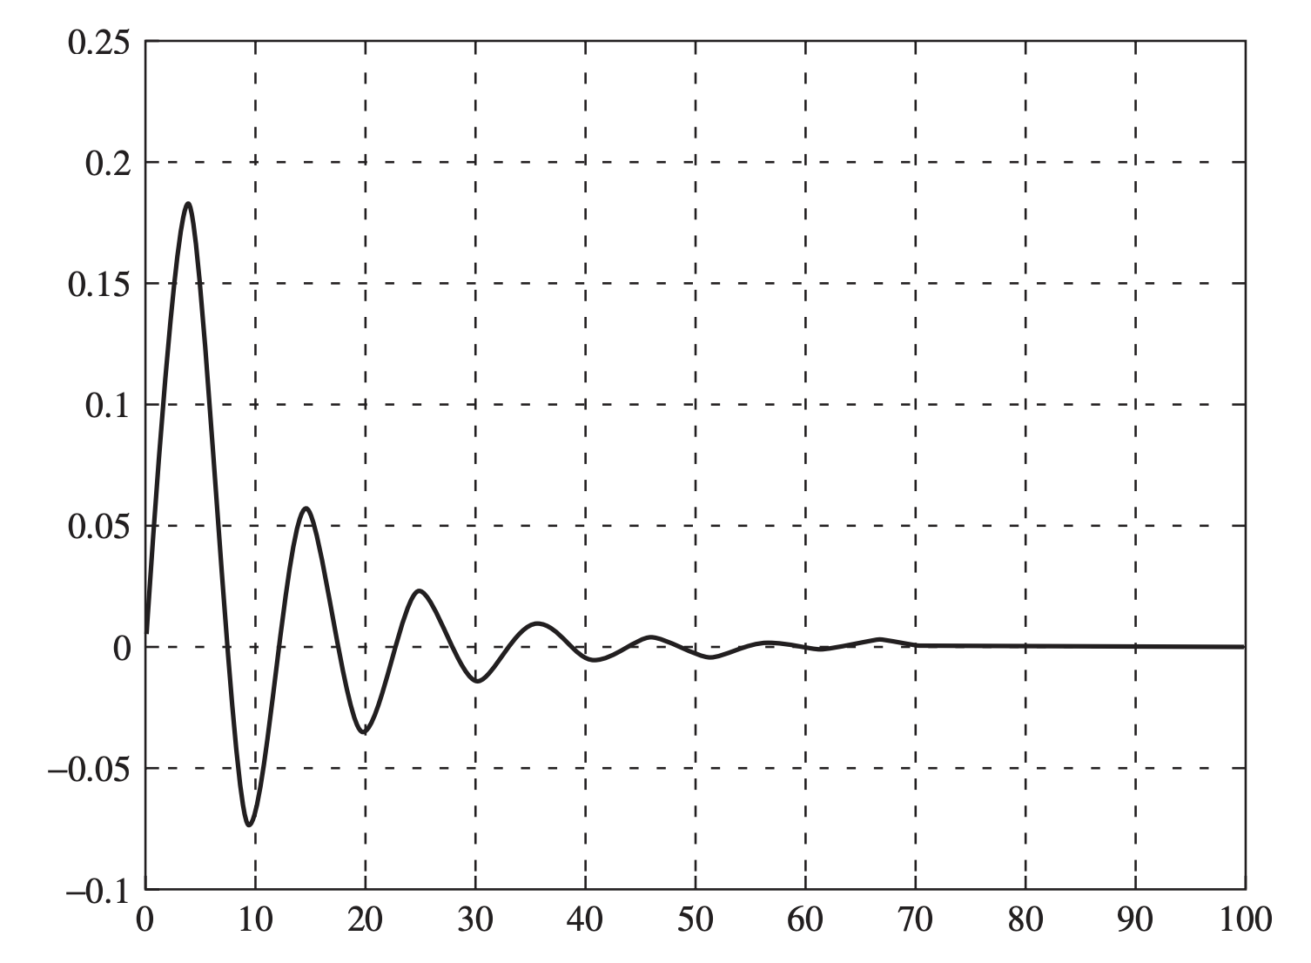
Controller Tuning
Criteria for good control
Control criteria applied to PI control
PI control Response

Slide 12
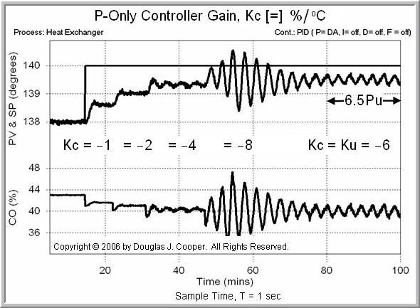
Tuning Rules
Zeigler-Nicholas (Z-N) Rules
Closed-loop tuning method
  Controller present and active
Ultimate gain K_{cu} and Ultimate period P_{u} are found by testing

Slide 13
Tuning Rules
Zeigler-Nicholas (Z-N) Rules
After the process reaches steady state at the normal level of operation,
  remove the integral and derivative modes of the controller, leaving only proportional control.
  On some PID controllers, this requires that the integral time t_{I} be set to its maximum value and the derivative time t_{D} to its minimum value.
  On computer-based controllers, the integral and derivative modes can be removed completely from the controller.

Slide 14
Tuning Rules
Zeigler-Nicholas (Z-N) Rules
Select a value of proportional gain K_{c}, disturb the system, and observe the transient response.
  If the response decays, select a higher value of Kc and again observe the response of the system.
  Continue increasing the gain in small steps until the response first exhibits a sustained oscillation.
  The value of gain and the period of oscillation that correspond to the sustained oscillation are the ultimate gain K_{cu} and the ultimate period P_{u}.

Slide 15
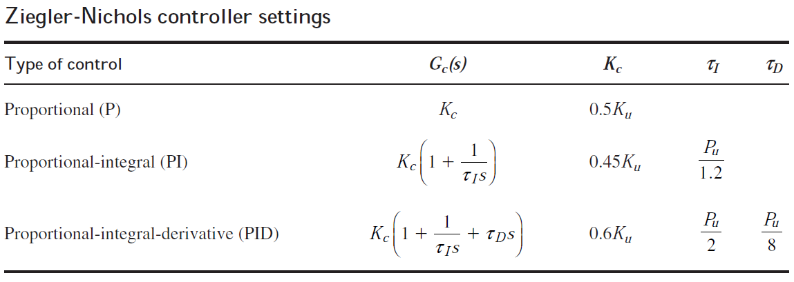
Tuning Rules
Zeigler-Nicholas (Z-N) Rules
From the values of K_{cu} and P_{u} found in step 2, use the Ziegler-Nichols rules given in Table to determine controller settings (K_{c}, t_{I} , t_{D} ).

Slide 16
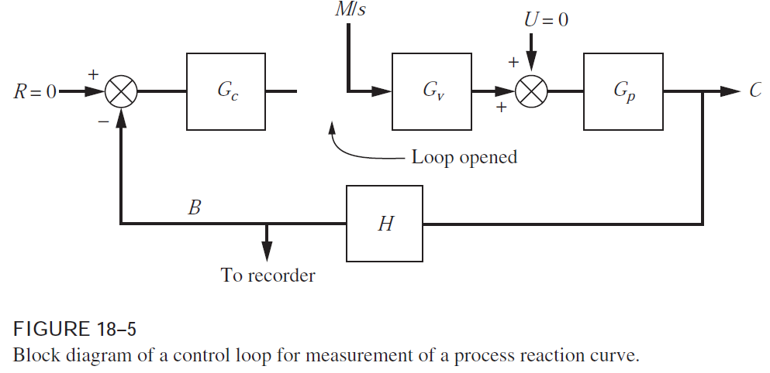
Tuning Rules
Cohen and Coon (C-C) Rules
Open-loop tuning method
  Controller action removed
Manual mode used
Step change (M/s) signal sent to the valve introduces open loop transient

Slide 17
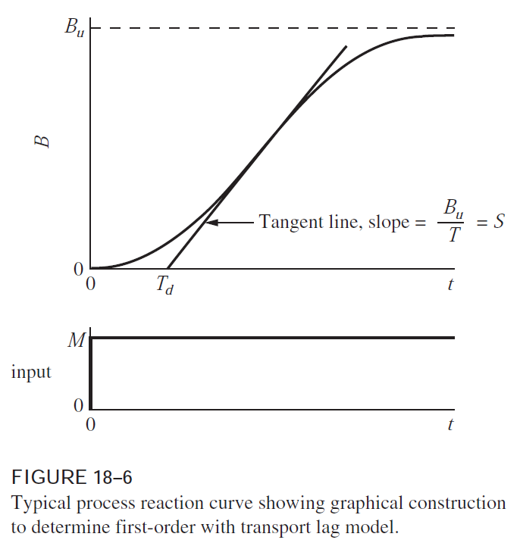
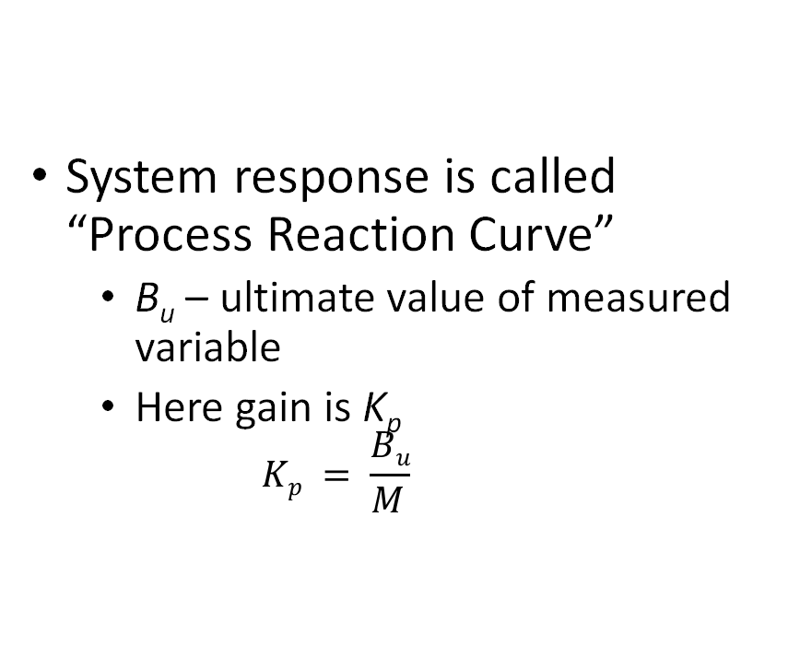
Tuning Rules
Cohen and Coon (C-C) Rules
System response is called “Process Reaction Curve”
  B_{u} – ultimate value of measured variable
  Here gain is K_{p}
    $$Kp = \frac{Bu}{M }$$

Slide 18
Tuning Rules
Cohen and Coon (C-C) Rules
After the process reaches steady state at the normal level of operation, switch the controller to manual.
  In a modern controller, the controller output will remain at the same value after switching as it had before switching.
    This is called “bumpless” transfer.
    With the controller in manual, introduce a small step change in the controller output that goes to the valve and record the transient, which is the process reaction curve.

Slide 19
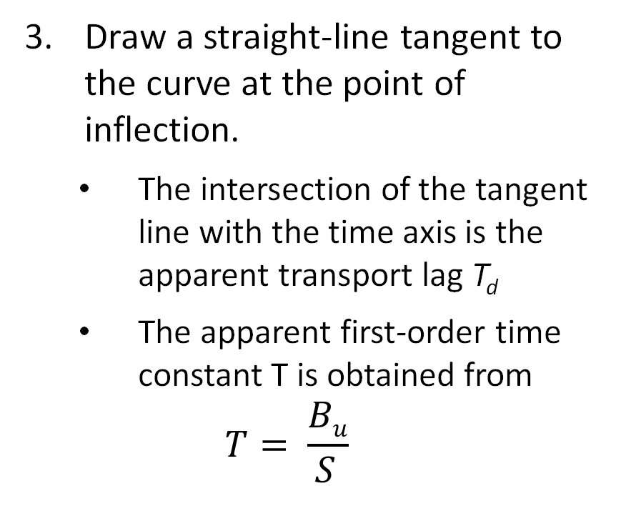
Tuning Rules
Cohen and Coon (C-C) Rules
    Draw a straight-line tangent to the curve at the point of inflection.
      The intersection of the tangent line with the time axis is the apparent transport lag T_{d}
      The apparent first-order time constant T is obtained from
      $$T= \frac{Bu}{S }$$

Slide 20
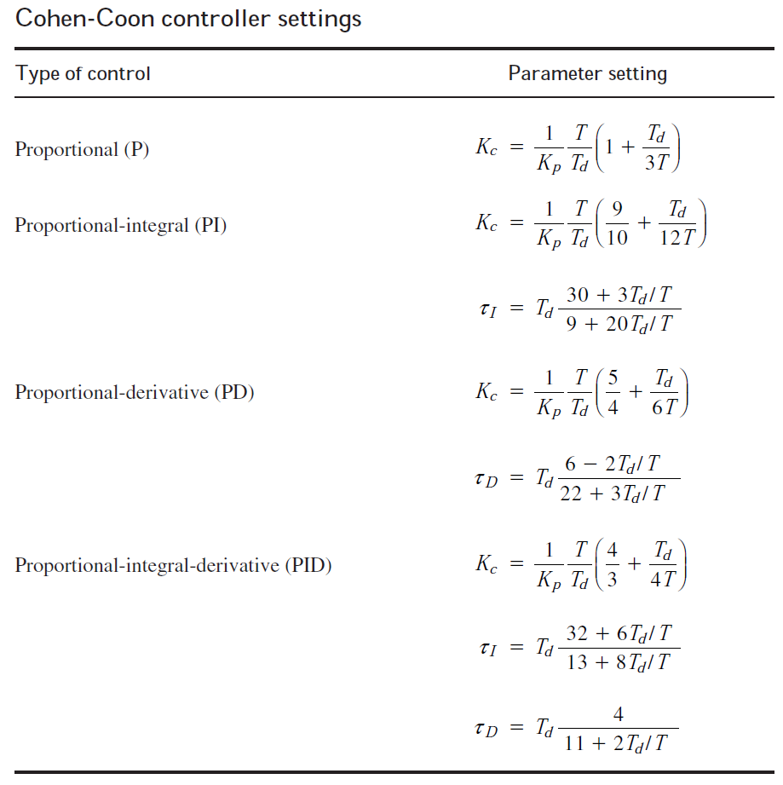
Tuning Rules
Cohen and Coon (C-C) Rules
Using the values of K_{p}, T, and T_{d} from step 3, the controller settings are found from the relations given in Table.

